Slide 1

Warby Parker Funnel
Learn SQL from Scratch
Darren Ohonba – Evans
01/12/2018

Slide 2
Contents
Survey response rate
Conversion through the funnel
A/B Test Results
Most popular survey results
Best selling glasses
Actionable Insights

Slide 3
Questions - Survey response rate
Question | Users that completed | Completion Rate
What are you looking for? | 500 | 100%
2. What's your fit? | 2. 475 | 95%
3. Which shapes do you like? | 3. 380 | 80%
4. Which colours do you like? | 4. 361 | 95%
5. When was your last eye exam? | 5. 270 | 74.8%
What do I think may be the reason behind this?
I think that the 2nd question has a high competition rate because it asks the user an easy question which only has 4 options to choose from. The user may believe that the question will narrow down their search for their perfect pair.
Question 3 may have a low completion rate because the user may not have a preference and be unsure of what to pick. And since all the shapes of glasses are very similar to each other this may cause choice paralysis. Maybe asking users to rate from Best to Good would help increase conversation.

Slide 4
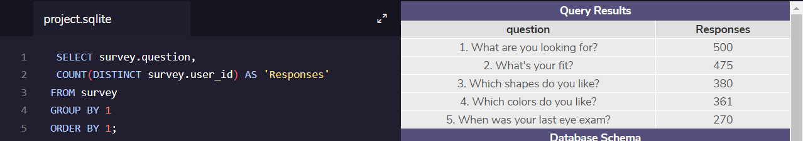
Question 5 has the lowest conversion rate, this may be because it is a personal question that people may not want to reveal to a website that they just landed on. Another reason could be that they don’t know how long ago their last eye exam meaning they might not want to answer the question.
I think ways to increase conversion would be to remind users that it’s fine if they don’t answer all the questions 100% accurately and their preferences can be changed in future. Emphasise the fact that the user will receive 5 free pairs of glasses once they can complete the survey.
SQL Query:

Slide 5
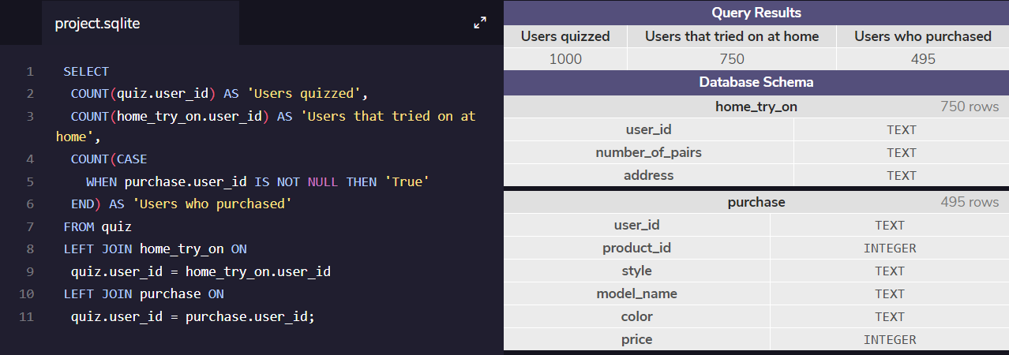
Conversion through the funnel
1000 users completed the quiz.
75% of users tried the glasses on at home. 750 people.
66% then went on to buy the glasses. 495 people.
An overall conversion rate of 49.5% who did the quiz, tried on at home and turned into paying customers.

Slide 6
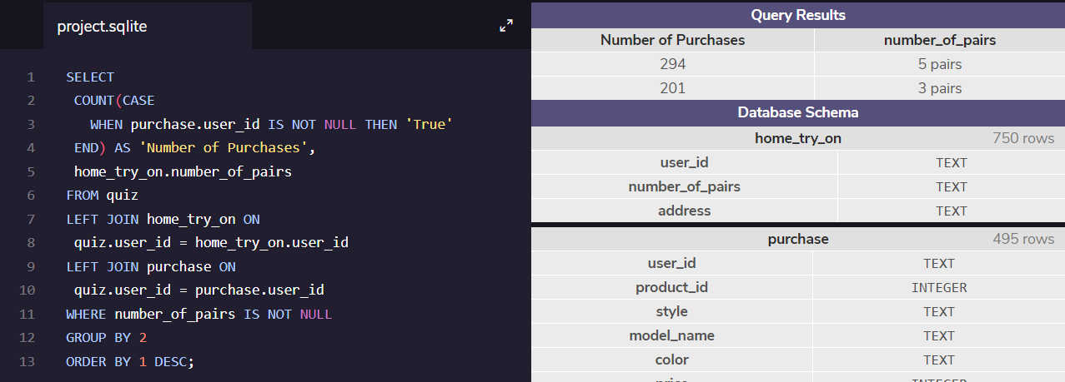
A/B TEST RESULTS
I calculated that 46% more people converted to customers using the percentage increase formula.
This query is used to visualise how many people each marketing campaign converted into customers. When the user was given 5 glasses to try on it resulted in 46% more sales compared to giving 3 glasses. The user may have more likely to find a pair they liked when given 5 pairs compared to 3 pairs.

Slide 7
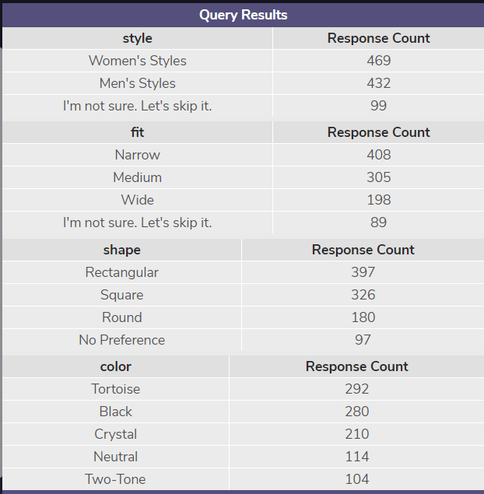
Most popular survey results
Here we see the most popular answer for each question that the user has been asked during the quiz. In total there are 1000 unique user who have completed the quiz.
The amount of people looking for men’s or women’s is quite similar.
From this query we could assume that narrow, rectangular, tortoise coloured glasses are the most popular choice. However we can’t be sure that user chose them in that combination.

Slide 8
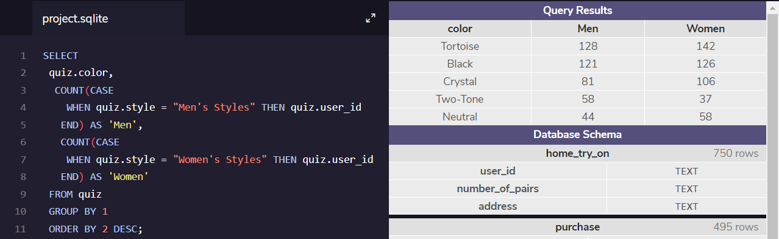
Colour Preference, Men vs Women
I also decided to run a query to see what the differences between the genders were like when it can to selecting a frame colour. Comparing the two most popular colours for both men and women (Tortoise and Black) there is not much difference.
30% more women chose Crystal colour compared to men however more men preferred Two-Tone compared to women.

Slide 9
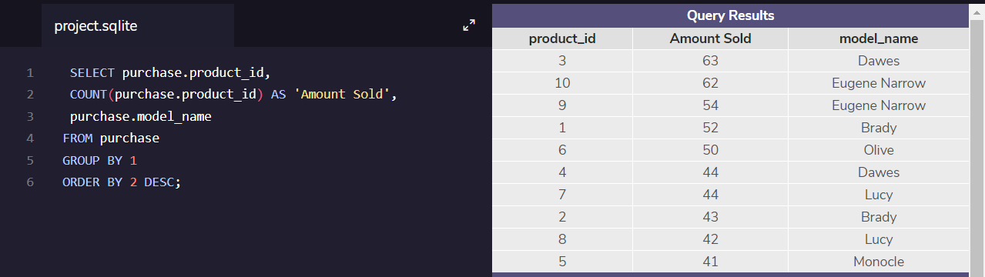
Best sellers
This query shows the product that sold the most from highest to lowest. product_id 3 sold the most at 63 units, product_id 5 sold the least at 41 units. The most popular brands being Dawes and Eugene Narrow.

Slide 10
Actionable insights
Survey
Firstly, We will explore ways that Warby Parker may be able to improve their survey completion rate. I believe that Warby Parker should let users rank their glasses shape preference for question 2 from Best to Good. E.x. Rectangular is Best, Round is Better and Square is Good. Or Warby Parker can remove and replace the question with one that is easier to answer.
Question 5 had the lowest completion rate and I think that may be because it is a personal question that the user doesn’t want to give to a “random” website or they may simply and forgotten and give up on the question. I would improve the question by giving the user a range to answer. E.g. 0 – 6 Months, 6+ Months, and not an exact date.
5 Pairs or 3 Pairs. A/B
The results from the A/B test show that people who were sent 5 pairs of glasses bought 50% more often than those who were sent 3 pairs. So Warby Parker should be sending out 5 pairs from now on.

